Slide 1
Ch.7 Terahertz Imaging
Lee Jong Geon

Slide 2
Contents
Image Resoultion of a Terahertz Imaging System
Data Analysis in the Far Field
Imaging Thin Layers
Spatial Resolution Tests
Near-Field Imaging
Chemical Imaging
Focal Plane Array Microbolometer Cameras

Slide 3
Image Resolution of
a Terahertz Imaging System

Slide 4
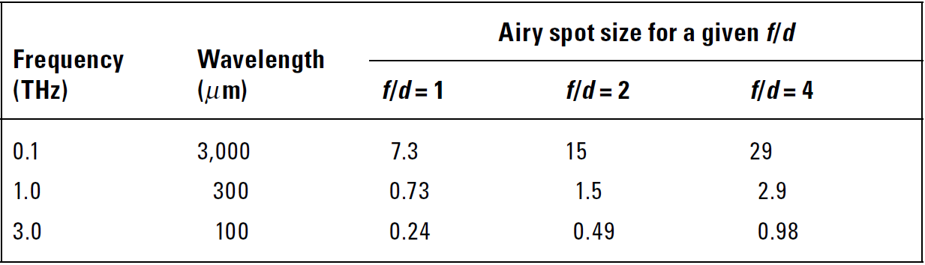

1. Image Resolution of a Terahertz Imaging System
Both spatial and depth resolution depends on the frequency and the optical design.
Spatial Resolution (Airy spot)
$$D_{Airy}=2.44\frac{f}{d}$$
Depth Reslotion
The shorter the pulse, the higher, in theory, is the resolution.
The majority of materials tend to suffer stronger absorption.

Slide 5
Data Analysis in the Far Field

Slide 6
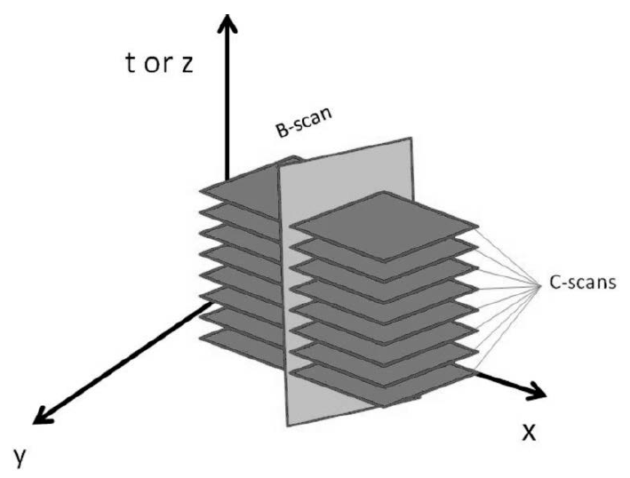
2. Data Analysis in the Far Field
The time-domain signal is recorded individually for each point and the image is formed by raster-scanning the object.
A-scan: point scan
B-scan: line scan
C-scan: area scan

Slide 7
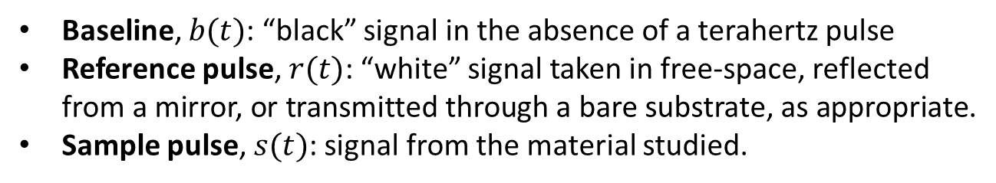
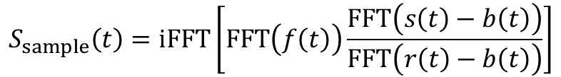

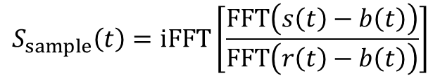
2. Data Analysis in the Far Field
$$S_{sample}\left(t\right)=iFFT\left[\frac{FFT\left(s\left(t\right)−b\left(t\right)\right)}{FFT\left(r\left(t\right)−b\left(t\right)\right)}\right]$$
Baseline, $b(t)$: “black” signal in the absence of a terahertz pulse
Reference pulse, $r(t)$: “white” signal taken in free-space, reflected from a mirror, or transmitted through a bare substrate, as appropriate.
Sample pulse, $s(t)$: signal from the material studied.
$$f\left(t\right)=\frac{1}{HF}e^{−\frac{t^{2}}{HF^{2}}}−\frac{1}{LF}e^{−\frac{t^{2}}{LF^{2}}}$$
$$S_{sample}\left(t\right)=iFFT\left[FFT\left(f\left(t\right)\right)\frac{FFT\left(s\left(t\right)−b\left(t\right)\right)}{FFT\left(r\left(t\right)−b\left(t\right)\right)}\right]$$
Aenchbacher, W., M. Naftaly, and R. Dudley, “Line Strengths and Self-Broadening of Pure Rotational Lines of Carbon Monoxide Measured by Terahertz Time-Domain Spectroscopy,” Applied Optics, Vol. 49, No. 13, 2010.

Slide 8
Imaging Thin Layers

Slide 9
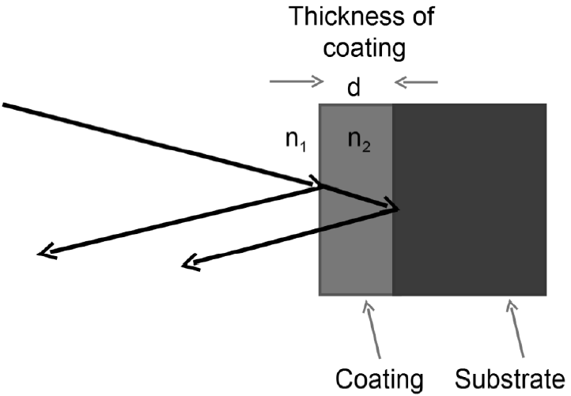
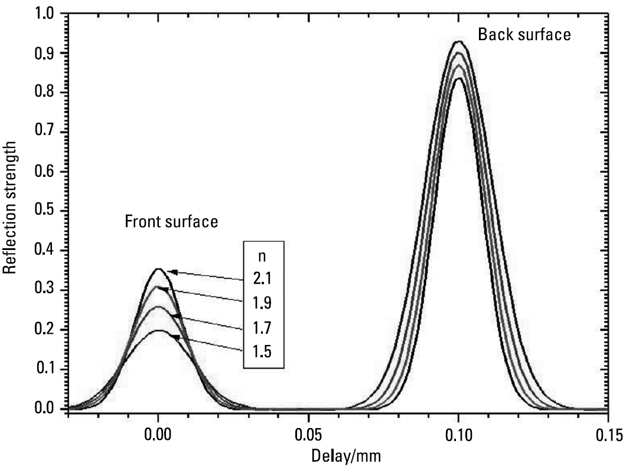
3. Imaging Thin Layers
First, the model takes into account only a single reflected pulse.
Material-Substrate
Air-Material

Slide 10
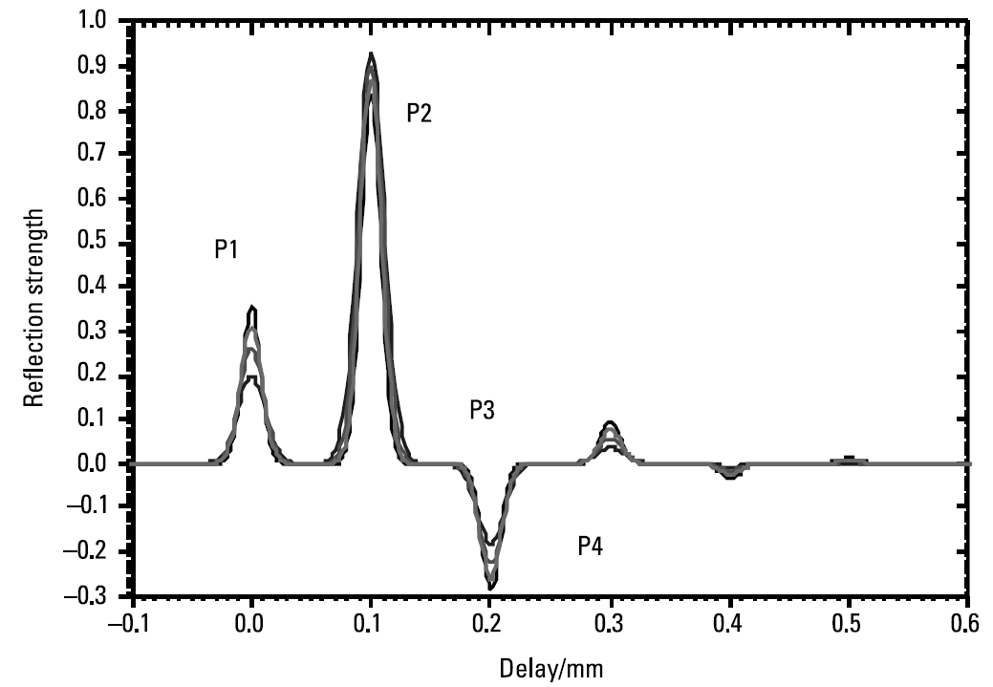
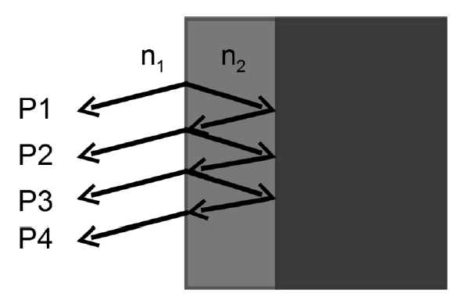
3. Imaging Thin Layers
In reality, multiple reflections occur.
Material-Substrate
Air-Material

Slide 11
Spatial Resloution Tests

Slide 12
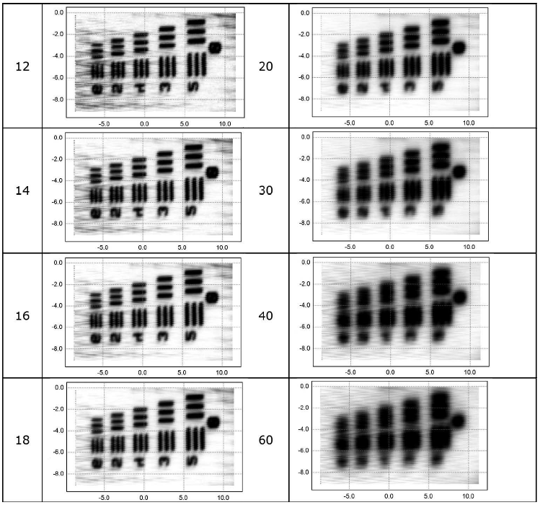
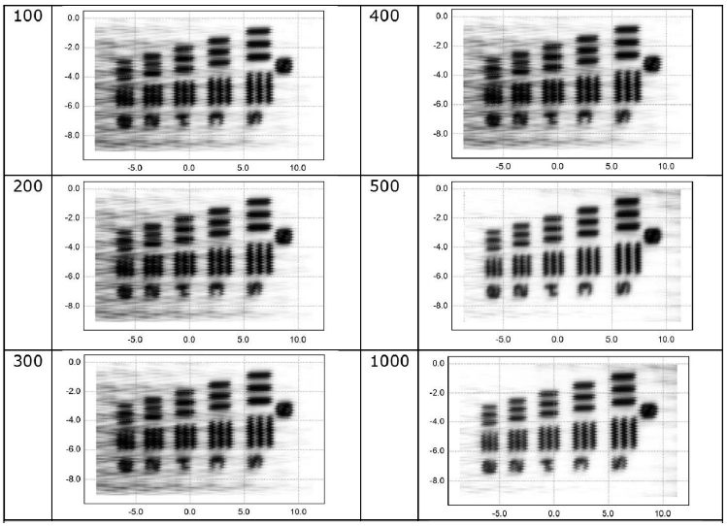
4. Spatial Resolution Tests
Increasing the HF ➔ reduction in the spatial resolution
Increasing the LF ➔ improve contrast

Slide 13
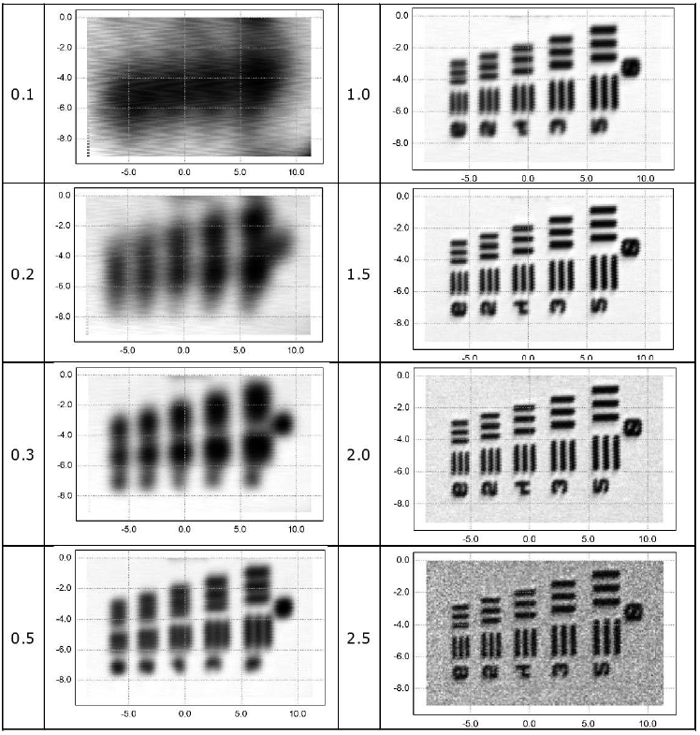
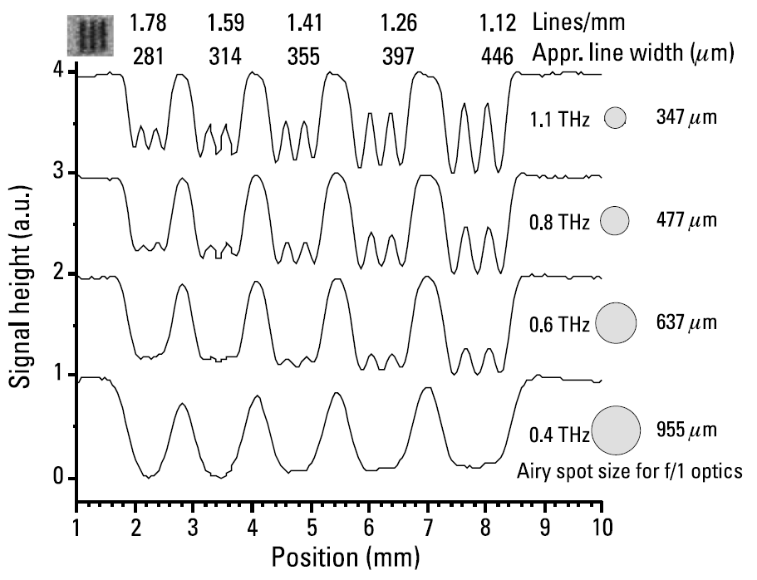
4. Spatial Resolution Tests
Below 0.5 THz, the lines are not resolved and cannot be seen.
The image at 2.5 THz, reduced SNR.

Slide 14
Near-Field Imaging

Slide 15
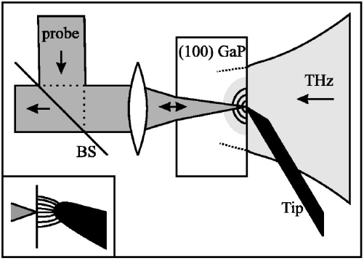
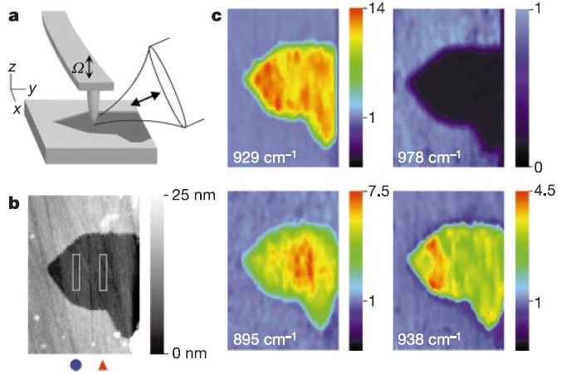
5. Near-Field Imaging
First applications restricted by necessity for the interactions to occur near the surface of the electro-optic crystal, thus limiting sample accessibility.
Recently developed, using aperture-less scattering scanning near-field optical microscopy, known as s-SNOM
Van der Valk, N. C. J., and P. C. M. Planken. “Electro-Optic Detection of Subwavelength Terahertz Spot Sizes in the Near Field of a Metal Tip,” Applied Physics Letters, Vol. 81, No. 9, 2002.
Hillenbrand, R., T. Taubner, and F. Keilmann, “Phonon-Enhanced Light-Matter Interaction at the Nanometre Scale,” Nature, Vol. 418, No. 6894, 2002.

Slide 16
Chemical Imaging

Slide 17
6. Chemical Imaging
First, the model takes into account only a single reflected pulse.

Slide 18
Focal Plane Array
Microbolometer Cameras

Slide 19
7. Focal Plane Array Microbolometer Cameras
First, the model takes into account only a single reflected pulse.

Slide 20
References
Aenchbacher, W., M. Naftaly, and R. Dudley, “Line Strengths and Self-Broadening of Pure Rotational Lines of Carbon Monoxide Measured by Terahertz Time-Domain Spectroscopy,” Applied Optics, Vol. 49, No. 13, 2010, pp. 2490-2496.
Molloy, J. F., et al., “Dispersion Properties of GaS Studied by THz-TDS,” Cryst. Eng. Comm., Vol. 16, 2014, pp. 1995-2000.
Van der Valk, N. C. J., and P. C. M. Planken. “Electro-Optic Detection of Subwavelength Terahertz Spot Sizes in the Near Field of a Metal Tip,” Applied Physics Letters, Vol. 81, No. 9, 2002, pp. 1558-1560.
Hillenbrand, R., T. Taubner, and F. Keilmann, “Phonon-Enhanced Light-Matter Interaction at the Nanometre Scale,” Nature, Vol. 418, No. 6894, 2002, pp. 159-162.

